Slide 1
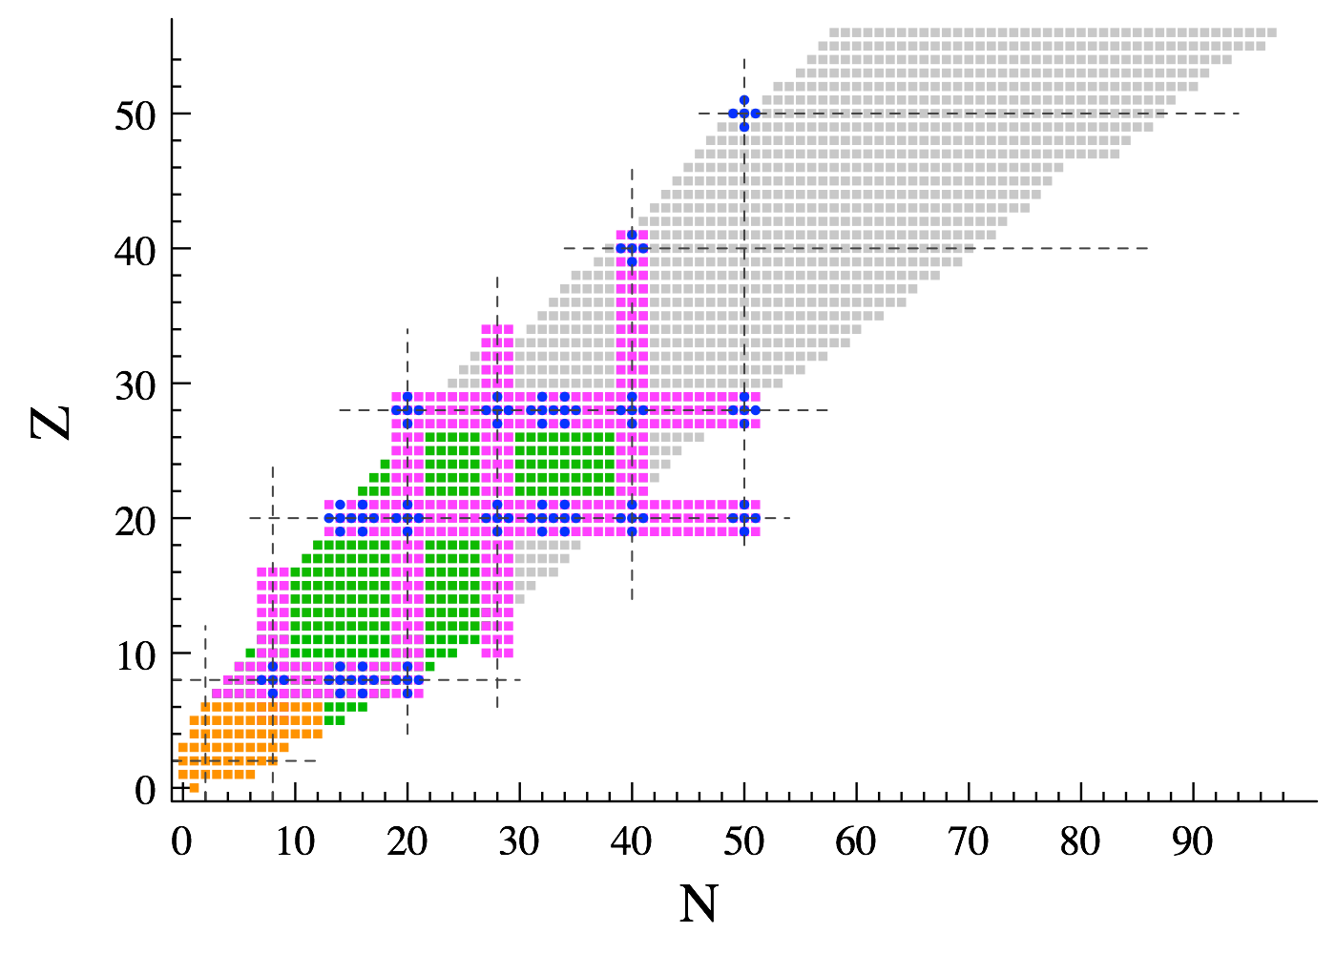



Panorama of the methods in each discipline
II. Low-energy Nuclear Physics
2021
Thomas DUGUET
DPhN, CEA-Saclay, France
IKS, KU Leuven, Belgium
Ab initio methods
Workshop on wave-function methods in quantum chemistry and nuclear physics
February 8-12 2021, GDR NBODY&RESANET

Slide 2

Workshop Program
Today
General background
Preparation and brief connection to days 2,3,5
Ab initio expansion methods for mid-mass nuclei
Leave entirely
CI and selected CI to Robert (wednesday)
Monte-Carlo to Denis&Lorenzo (thursday)
EDF, reaction theory to another meeting…
+ I benefit from Titou’s talk regarding HF, MBPT, CC…

Slide 3
Contents
⦿ Introduction to low-energy nuclear physics
○ Phenomenology
○ Rationale from the theoretical viewpoint
⦿ Strong inter-nucleon forces
○ Basic phenomenology and modelling
⦿ The ab initio nuclear many-body problem
○ Characteristics of the mean-field
○ Pre-processing short-range correlations
○ Expansion methods
○ Dealing with static and dynamical correlations
○ Reducing the numerical scaling
⦿ Conclusions

Slide 4
Contents
⦿ Introduction to low-energy nuclear physics
○ Phenomenology
○ Rationale from the theoretical viewpoint
⦿ Strong inter-nucleon forces
○ Basic phenomenology and modelling
⦿ The ab initio nuclear many-body problem
○ Characteristics of the mean-field
○ Pre-processing short-range correlations
○ Expansion methods
○ Dealing with static and dynamical correlations
○ Reducing the numerical scaling
⦿ Conclusions

Slide 5
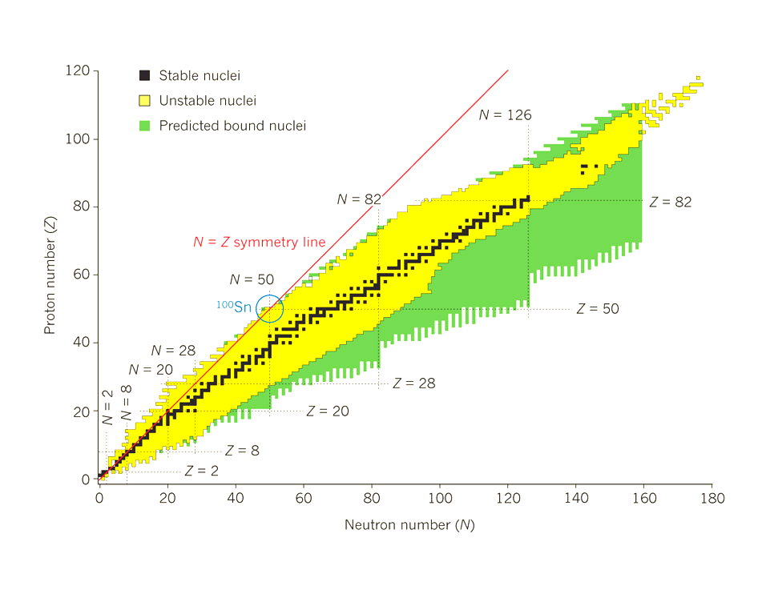
The simple of view of an atomic nucleus
❶ Self-bound (or resonant) state of Z protons and N neutrons
Sketch of an atom
4-fermions system (spin up/down ⊗ isospin up/down)
electron
❷Residual strong force between color-less objects
nucleus
Courtesy of A. Tichai
proton
neutron
Nuclear chart

Slide 6
Elementary questions driving the field and our activity
How many nuclei are bound by the strong force; 6000-9000?
Less than 50% known (>10⁻²²s) → Discovery of ~15 per year in the years 2010s
→ Several 100s from next generation facilities
Where are magic numbers over the nuclear chart?
N=20/28 shown to disappear away from stability in 1975/1993
What is the heaviest possible element?
₁₁₈Og added to Mendeleïev table in 2016
What are the various radioactive decay modes?
Nuclear chart
2p decay identified beyond the proton dripline in ⁴⁵Fe in 2002
How have heavier elements than Fe been produced?
Where is the neutron drip-line?
Gravitational wave + kilonova from neutron stars merger in 2017
Extended from Z=8 (²⁴O) to Z=10 (³⁴Ne) in 2019

Slide 7


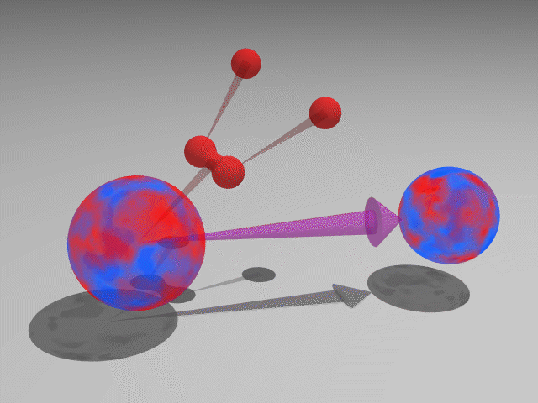
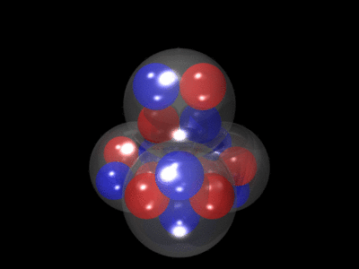
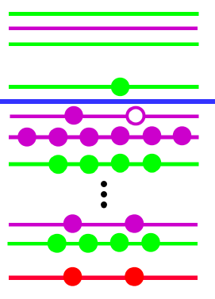
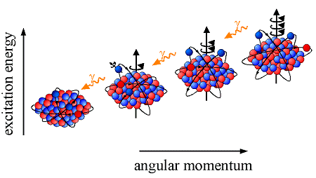
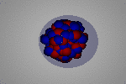
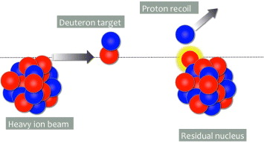
The atomic nucleus as a 4-components quantum mesoscopic system
An extremely rich and diverse phenomenology
Nucleus: bound (or resonant) state of Z protons and N neutrons
Several scales at play:
Ground state
Mass, size, superfluidity, e.m. moments…
p & n momenta ~ 10⁸ eV
Separation energies ~ 10⁷ eV
Vibrational excitations~ 10⁶ eV
“Ab initio”, i.e. Chiral-EFT in A-body sector, long-term endeavor
Can nuclear systems be described
Consistently (from a single theoretical rationale?)
Systematically (complete phenomenology?)
Accurately enough (relevant to experimental uncertainty?)
From inter-nucleon interactions (right balance between reductionism/emergence?)
Rooted in QCD (sound connection to underlying EFT?)
Rotational excitations ~ 10⁴ eV
Radioactive decays
β, 2β, 0ν2β, α, p, 2p, (≠)fission, …
Exotic structures
Clusters, halos, …
Spectroscopy
Excitation modes
Reaction processes
Fusion, transfer, knockout, …

Slide 8
Contents
⦿ Introduction to low-energy nuclear physics
○ Phenomenology
○ Rationale from the theoretical viewpoint
⦿ Strong inter-nucleon forces
○ Basic phenomenology and modelling
⦿ The ab initio nuclear many-body problem
○ Characteristics of the mean-field
○ Pre-processing short-range correlations
○ Expansion methods
○ Dealing with static and dynamical correlations
○ Reducing the numerical scaling
⦿ Conclusions

Slide 9


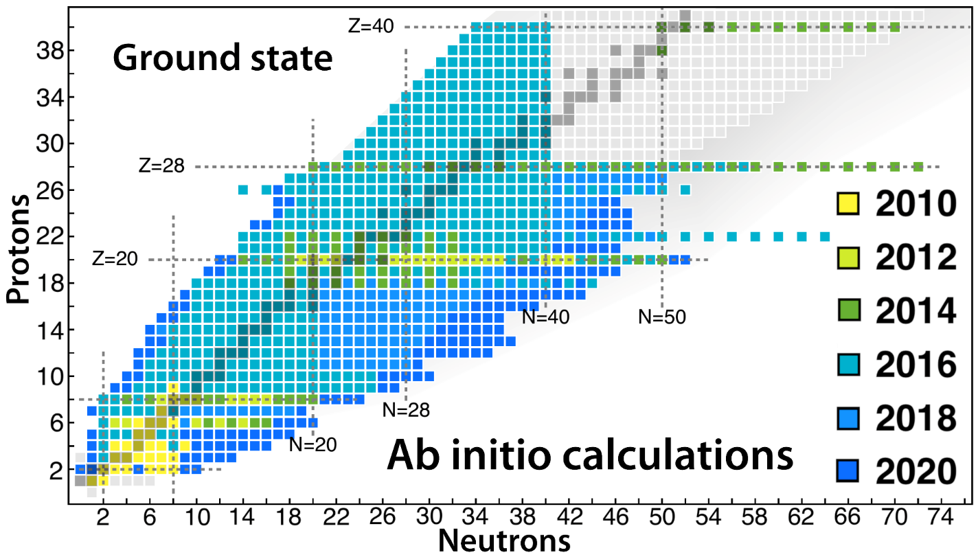
Ab initio (i.e. In medias res) quantum many-body problem
Ab initio nuclear many-body theory = Chiral Effective Field Theory (χEFT) in A-nucleon sector
1) A structure-less nucleons as degrees of freedom at low energy
2) Interactions mediated by pions and contact operators based on, e.g., Weinberg, power counting
3) Solve A-body Schrödinger equation to relevant accuracy
A-body Schrödinger Equation
1
2
3
Rapidly evolving field in the last 15 years
Modeling
SE
QCD
Data
Chiral EFT
1) H
4
“Ab initio”
2) SE
Feedback
H. Hergert, Front. in Phys. 8 (2020) 379

Slide 10
Contents
⦿ Introduction to low-energy nuclear physics
○ Phenomenology
○ Rationale from the theoretical viewpoint
⦿ Strong inter-nucleon forces
○ Basic phenomenology and modelling
⦿ The ab initio nuclear many-body problem
○ Characteristics of the mean-field
○ Pre-processing short-range correlations
○ Expansion methods
○ Dealing with static and dynamical correlations
○ Reducing the numerical scaling
⦿ Conclusions

Slide 11
The nuclear Hamiltonian
Build H (and other operators) with χEFT at various orders
⦿ Non-trivial formal task whose difficulty increases with order (e.g. 3N at N²LO, 4N at N³LO…)
⦿ Fit LECs of mode-2k tensor to experimental data (or lattice QCD) in A = k-body systems
Organization = power counting
Importance of interaction terms
A-body Schrödinger Equation
Effective description = A-body operator in principle
At least 3N necessary = major difficulty to solve SE next
For the actual construction of V^{kN} operators via χEFT
➲ See my talk at the GDR NBODY kickoff meeting, Lille, January 2020
➲ Not recalled here

Slide 12
Symmetries of the nuclear Hamiltonian
Nuclear systems are
❶ Translationally invariant: T(1)
[H,P_{i}] = 0  | Φ^{P}_{cm} > | Ψ_{im} >
❷ Rotationally invariant: SU(2)
[H,J²] = [H,J_{z}] = 0  | Ψ^{JM} >
❸ Carry fixed neutrons/protons numbers: U(1)
[H,N] = [H,Z] = 0  | Ψ^{JMNZ} >
❹ + additional symmetries (time reversal, parity, ~isospin)
Total center-of-mass momentum
Symmetries
❶ Strongly constrain the mathematical form of H
❷ Dictates quantum numbers of its eigenstates
e.g. factorization of cm hard to ensure in practice
Total (internal) angular momentum

Slide 13
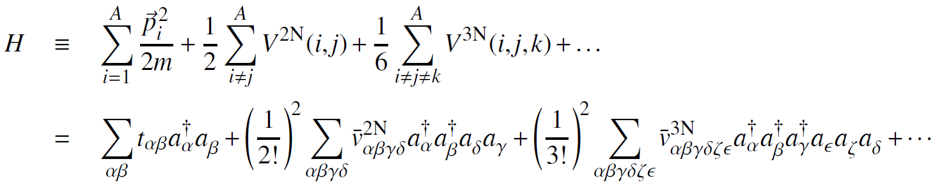
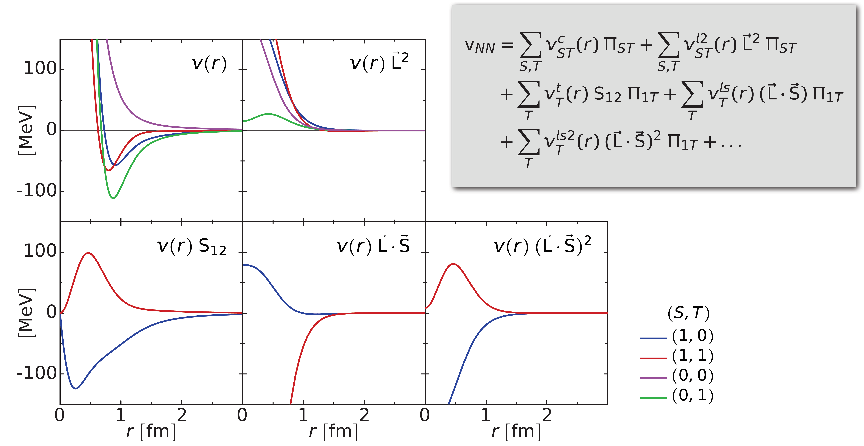
Phenomenology of inter-nucleon interactions
Interactions between effective 4-components point fermions
➲ nucleons = ±½ isospin & ±½ spin projections
1. Complex operator structure in r⊗σ⊗τ spaces (constrained by symmetries)
AV18 2N interaction
Central operator
~Lennard-Jones
Short-range repulsion
Tensor operator
Spin-orbit
Spin-orbit²
Courtesy of R. Roth
[Wiringa et al. 1995]
4 two-body spin-isospin channels
[See talks by A. Tichai & R. Roth for further discussions]
AV18 model local but generally nuclear interactions are non-local in space

Slide 14
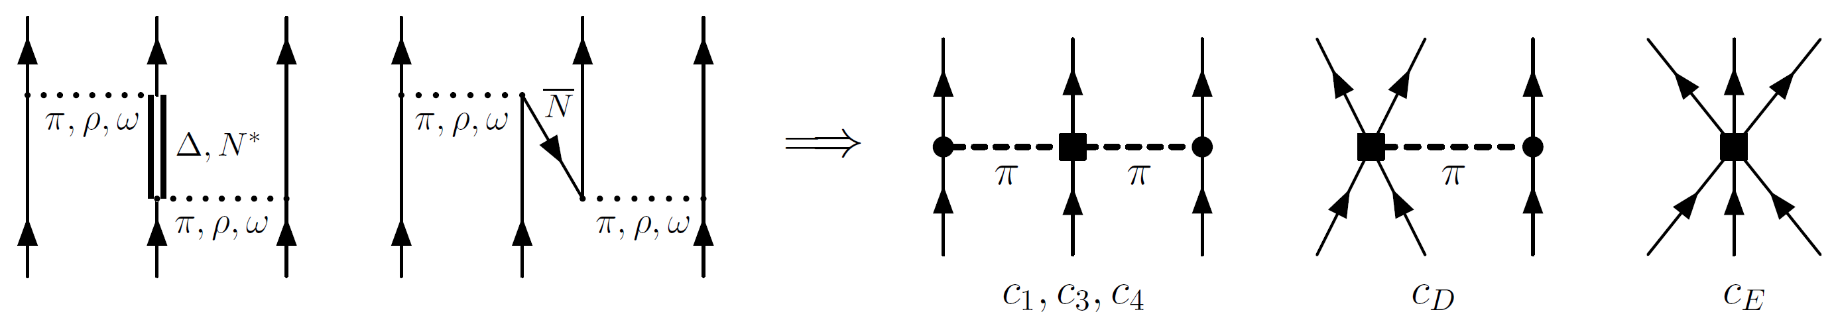
Phenomenology of inter-nucleon interactions
Interactions between effective 4-components point fermions
➲ nucleons = ±½ isospin & ±½ spin projections
2. Dominant 2-nucleon + sub-leading (but mandatory) 3-nucleon and (minor?) 4-nucleon forces
« Integrating out » DOFs lead to multi-nucleon forces
Example 3N
2π-exchange diagram
First contributions to 3N interaction in chiral-EFT (N²LO)
Example of analytical expression
Tensor operator
Low-Energy Constants (LECs)
Spin-orbit-like operator
ME in plane-wave basis of H₃
Fixed on π-nucleon scatt. exp.

Slide 15
Contents
⦿ Introduction to low-energy nuclear physics
○ Phenomenology
○ Rationale from the theoretical viewpoint
⦿ Strong inter-nucleon forces
○ Basic phenomenology and modelling
⦿ The ab initio nuclear many-body problem
○ Characteristics of the mean-field
○ Pre-processing short-range correlations
○ Expansion methods
○ Dealing with static and dynamical correlations
○ Reducing the numerical scaling
⦿ Conclusions

Slide 16
Nuclear many-body problem
A-body Schrödinger Equation
Ex:
+ ∅ because of the truncation of χEFT expansion of the operator

Slide 17
Contents
⦿ Introduction to low-energy nuclear physics
○ Phenomenology
○ Rationale from the theoretical viewpoint
⦿ Strong inter-nucleon forces
○ Basic phenomenology and modelling
⦿ The ab initio nuclear many-body problem
○ Characteristics of the mean-field
○ Pre-processing short-range correlations
○ Expansion methods
○ Dealing with static and dynamical correlations
○ Reducing the numerical scaling
⦿ Conclusions

Slide 18
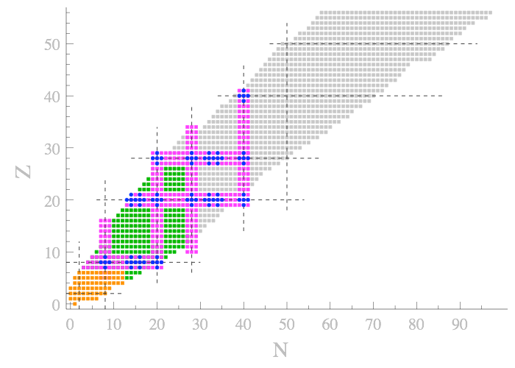
Specificities of atomic nuclei: mean field
RHF mean-field
Specificities
Self-bound system
Neutrons & protons
SU(2) sym. + strong L.S
1) Self created/centered
2) One for each species
3) j=l+s → 2j+1 degeneracy
approximation
Average potential
50
Filling of nuclear shells
¹⁰⁰Sn
¹³²Sn
50
28
20
« Magic » numbers
Protons
Neutrons
Overstable systems
⁵⁶Ni
⁶⁸Ni
⁷⁸Ni
8
28
⁴⁰Ca
⁴⁸Ca
20
2
Doubly closed-shell (DCS) (+/-1) nuclei
Singly open-shell (SOS) (+/-1) nuclei
Doubly open-shell (DOS) nuclei
¹⁶O
²⁸O
8
⁴He
2
Mostly open-shell ground-states
Strong (« static ») correlations

Slide 19
Contents
⦿ Introduction to low-energy nuclear physics
○ Phenomenology
○ Rationale from the theoretical viewpoint
⦿ Strong inter-nucleon forces
○ Basic phenomenology and modelling
⦿ The ab initio nuclear many-body problem
○ Characteristics of the mean-field
○ Pre-processing short-range correlations
○ Expansion methods
○ Dealing with static and dynamical correlations
○ Reducing the numerical scaling
⦿ Conclusions

Slide 20
Pre-processing of short-range correlations
Beyond mean-field
Many-body
1) Dynamic corr. in UV
2) Strong static corr. in IR
2a) Pairing in SOS
2b) Collect. Quad. in DOS
1) Short-r repulsion
2) Bound np/Virtual nn
expansion
correlations
Residual interaction
Taming down the short-range/coupling to UV in the Hamiltonian
Unitary Similarity Renormalization Group (SRG) transformation
♦ Paramaterize the change of the Hamiltonian
Anti-hermitian generator
specifies the transformation
when
Trivial fixed point
H(s) diagonal
♦ To tame short-range choose = diagonal in momentum space basis
♦ Do not go all the way to fixed point because induces multi-body operators in H(s)
Run until appropriate s_{final} = pre-diagonalization

Slide 21
Pre-processing of short-range correlations
Beyond mean-field
Many-body
1) Dynamic corr. in UV
2) Strong static corr. in IR
2a) Pairing in SOS
2b) Collect. Quad. in DOS
1) Short-r repulsion
2) Bound np/Virtual nn
expansion
correlations
Taming down the short-range/coupling to UV in the Hamiltonian
Unitary Similarity Renormalization Group (SRG) transformation
2N
[Roth, Reinhardt, Hergert 2008]
Relative momentum basis of H₂
Remaining dynamical/static correlations
➲ Still ~2000 basis states needed in mid mass
Drastically accelerated convergence
More perturbative behavior in the UV
Low-to-high off-diagonal matrix elements suppressed
Limit to DCS&SOS to utilize AMC → 200 states [See talk by A. Tichai]
Limit to « low » orders (CCSD(T), IMSRG(2), MBPT(3))
Limit to mid mass (A~100)
➲ Similar SRG procedure and achievement for 3N in H₃ [See talks by A. Tichai & R. Roth for further details]

Slide 22
Pre-processed nuclear many-body problem
SRG
A-body Schrödinger Equation
Rather strong coupling to UV
Ex:
+ ∅ because of the truncation of chiral-EFT expansion of the operator

Slide 23
Pre-processed nuclear many-body problem
« Soft » Hamiltonian
=
much reduced coupling to UV
A-body observables independent of s
A-body Schrödinger Equation
Ex:
to be tractable
violate unitarity
Induced k-body forces (k≤ A)
Choose truncation & s
SRG transformation is a compromised between
➲ Reduction of coupling to UV
➲ Size of induced k-body interactions that cannot be handled

Slide 24
Contents
⦿ Introduction to low-energy nuclear physics
○ Phenomenology
○ Rationale from the theoretical viewpoint
⦿ Strong inter-nucleon forces
○ Basic phenomenology and modelling
⦿ The ab initio nuclear many-body problem
○ Characteristics of the mean-field
○ Pre-processing short-range correlations
○ Expansion methods
○ Dealing with static and dynamical correlations
○ Reducing the numerical scaling
⦿ Conclusions

Slide 25
Expansion many-body methods
2) Include remaining dynamical and static correlations
Introduce importance sampling/selection
Cost of solving SE scales as N^{A} = limited to A < 12
Wednesday/Thursday
Design expansion methods scaling as N^{p}
I. Mean-field reference state
Today/Tuesday/Friday
Symmetry-conserving partitioning
such that
Closed-shell
Stands for N&Z
Exactly solvable
Spherical Slater determinant (« RHF »)
II. Many-body expansion
Non-degenerate
Good starting point for expansion
III. Examples in nuclear physics
SCGF
Self-Consistent Green’s Function [ADC(2,3)]
Wave operator
Reference state
MBPT
Many-Body Perturbation theory [(2,3)]
►Expand in terms of elementary (np-nh) excitations of | Φ₀ >
►Accounts for « weak/dynamical » correlations
►Expand as a series (MBPT, CC…) + truncate = N^{p} cost
CC
Coupled Cluster [Λ-CCSD(T), CR-CC(2,3)]
IM-SRG
In-Medium Similarity Renormalization Group

Slide 26
In-medium similarity renormalization group method
Goal: Solve SRG flow equation in H_{A} such that | Φ₀ > is the GS of H(∞)
1. Normal order H with respect to | Φ₀ > (instead of | 0 > for standard SRG)
Working basis of H₁ & MEs calculation [see Talk by A. Tichai]
Hamiltonian
holes
Reference state (« RHF »)
with
particles
Standard Wick’s theorem
Normal-ordered (NO) with respect to | Φ₀ >
HF basis & MEs transformation [see Talk by A. Tichai]
[Hergert et. al, Phys. Rep. 2016]

Slide 27
In-medium similarity renormalization group method
Matrix elements of nomal-ordered operators
Large part of the original 3N transfered into effective lower-rank tensors/NO operators
Neglect residual NO 3N operator = NO2B approx
Many-body machinery with 2N operators only (1-3% error benchmarked up ¹⁶O via IT-NCSM)
[Roth et al., PRL (2012)]

Slide 28
In-medium similarity renormalization group method
Basis of H_{A}= elementary (npnh) excitations of | Φ₀ >
2. Flow equation for normal-ordered form of H(s)
Initial condition
n
m
Flow equation
each step
up to n+m-1
Induced k-body terms
Neglect flowing k-body operators with n ≤ k ≤ A = IMSRG(n) approx → violates unitarity (small?)
IMSRG(2) workhorse of current ab initio calculations
Pursued decoupling
Associated « off-diagonal » Hamiltonian defining η(s)
ph&pphh matrix elements
with

Slide 29
In-medium similarity renormalization group method
2. Agebraic form of the coupled flow equations in the IMSRG(2) approximation
Evaluate through Wick’s theorem
Size extensive
Connected diagrams only
pp-hh ladders
+ interferences as s → ∞
p-h rings
Scale as N⁶ ⇔ CCSD

Slide 30
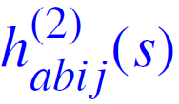
In-medium similarity renormalization group method
N³LO chiral-EFT (no 3N here) SRG evolved λ = 2 fm⁻¹
Decoupling
Well under way after 20 steps (s=2.0)
Numerically achieved at s=18.3
Convergence
MBPT(2)/CCSD/Λ-CCSD(T) with evolving H(s)
Beyond s=2.0 ⇔ full decoupling achieved
❖ ⇔ understood from MBPT(n) analysis
➲ Current challenge is to go to IMSRG(3) truncation order
[Hergert et. al, Phys. Rep. 2016]

Slide 31
Expansion many-body methods
2) Include remaining dynamical correlations and static correlations in the IR
Introduce importance sampling
Cost of solving SE scales as N^{A} = limited to A < 12
Wednesday/Thursday
Design expansion methods scaling as N^{p}
I. Mean-field reference state
Today/Tuesday/Friday
Symmetry-conserving partitioning
such that
Closed-shell
Stands for N&Z
Exactly solvable
Spherical Slater determinant (« RHF »)
II. Many-body expansion
Non-degenerate
Good starting point for expansion
Open-shell
Wave operator
Reference state
►Expand in terms of elementary (np-nh) excitations of | Φ₀ >
►Accounts for « weak/dynamical » correlations
►Expand as a specific series (MBPT, CC…) + truncate = N^{p} cost
Degenerate
Improper starting point for expansion
Most of nuclear GS are open-shell…

Slide 32
Contents
⦿ Introduction to low-energy nuclear physics
○ Phenomenology
○ Rationale from the theoretical viewpoint
⦿ Strong inter-nucleon forces
○ Basic phenomenology and modelling
⦿ The ab initio nuclear many-body problem
○ Characteristics of the mean-field
○ Pre-processing short-range correlations
○ Expansion methods
○ Dealing with static and dynamical correlations
○ Reducing the numerical scaling
⦿ Conclusions

Slide 33
Static correlations and (near) degenerate systems
I. The basic facts
Closed-shell RHF reference vacuum
Open-shell RHF reference vacuum
Gap-full elementary excitation (EE) spectrum
Gap-less EE spectrum
Gap to first excited state
Vacuum
Vacuum
No gap
Ignite static correlations
Nature&Strength
➲ h⁽²⁾ in IR
Controlled expansions
Singular expansions
Ex:
Ex:

Slide 34
Static correlations and (near) degenerate systems
II. Possible remedies
Depends on SOS vs DOS
[See talk by B. Bally]
Multi-reference (MR) state from orthonormal EE in IR
Spontaneous symmetry-breaking (SSB)
« UV »
Space
From diago
Opens a gap
1) Break SU(2)
UHF state
2) Break U(1)
HFB state
3) Break both or others
UHFB state
« IR »
Space
Ex: SU(2)
Re-opens a gap in EE spectrum
Controlled expansions on top of MR state
Gap-full SSB-EE spectrum
Capture static correlations
Controlled expansions on top of single-reference SSB state
with
Typical of QC
Ex:
Truncated series breaks symmetry
Symmetry must eventually be restored
✶ PBMBPT, PCC [Duguet 2015, Qiu et al. 2017, 2020]
MR-MBPT, MR-CC…
Typical of NP
Breaking of U(1)
GSCGF, BMBPT, BCC, GSCGF,…

Slide 35
Ex. Bogoliubov many-body perturbation theory
[Duguet, Signoracci 2016]
⦿ Perturbative reduction of BCC
→ Code for automated generation&evaluation of many-body diagrams to arbitrary order
[Arthuis et al. 2018]
→ Convergence properties at high orders and resummation methods
[Demol et al. 2020]
⦿ Validation of BMBPT(2,3) in mid-mass SOS nuclei
[Tichai et al. 2018]
Calculation details
Chiral NN+3N Hamiltonian
SRG α = 0.08 fm⁴
13 major shells (1820 s.p. states)
Canonical HFB reference
Runtime
NCSM: 20.000 hours
MCPT: 2.000 hours
IMSRG(2): 1.500 hours
SCGF(2): 400 hours
    BMBPT(2): < 1min !
→ 2-3% agreement of all methods with exact results (IT-NCSM)
→ Consistent with non-perturbative methods for basic ground-state properties
Optimal for first (i) test of novel χEFT Hamiltonians (ii) exploration of large A
Refined observables require non-perturbative methods (at high order)
[Tichai et al. 2020]

Slide 36
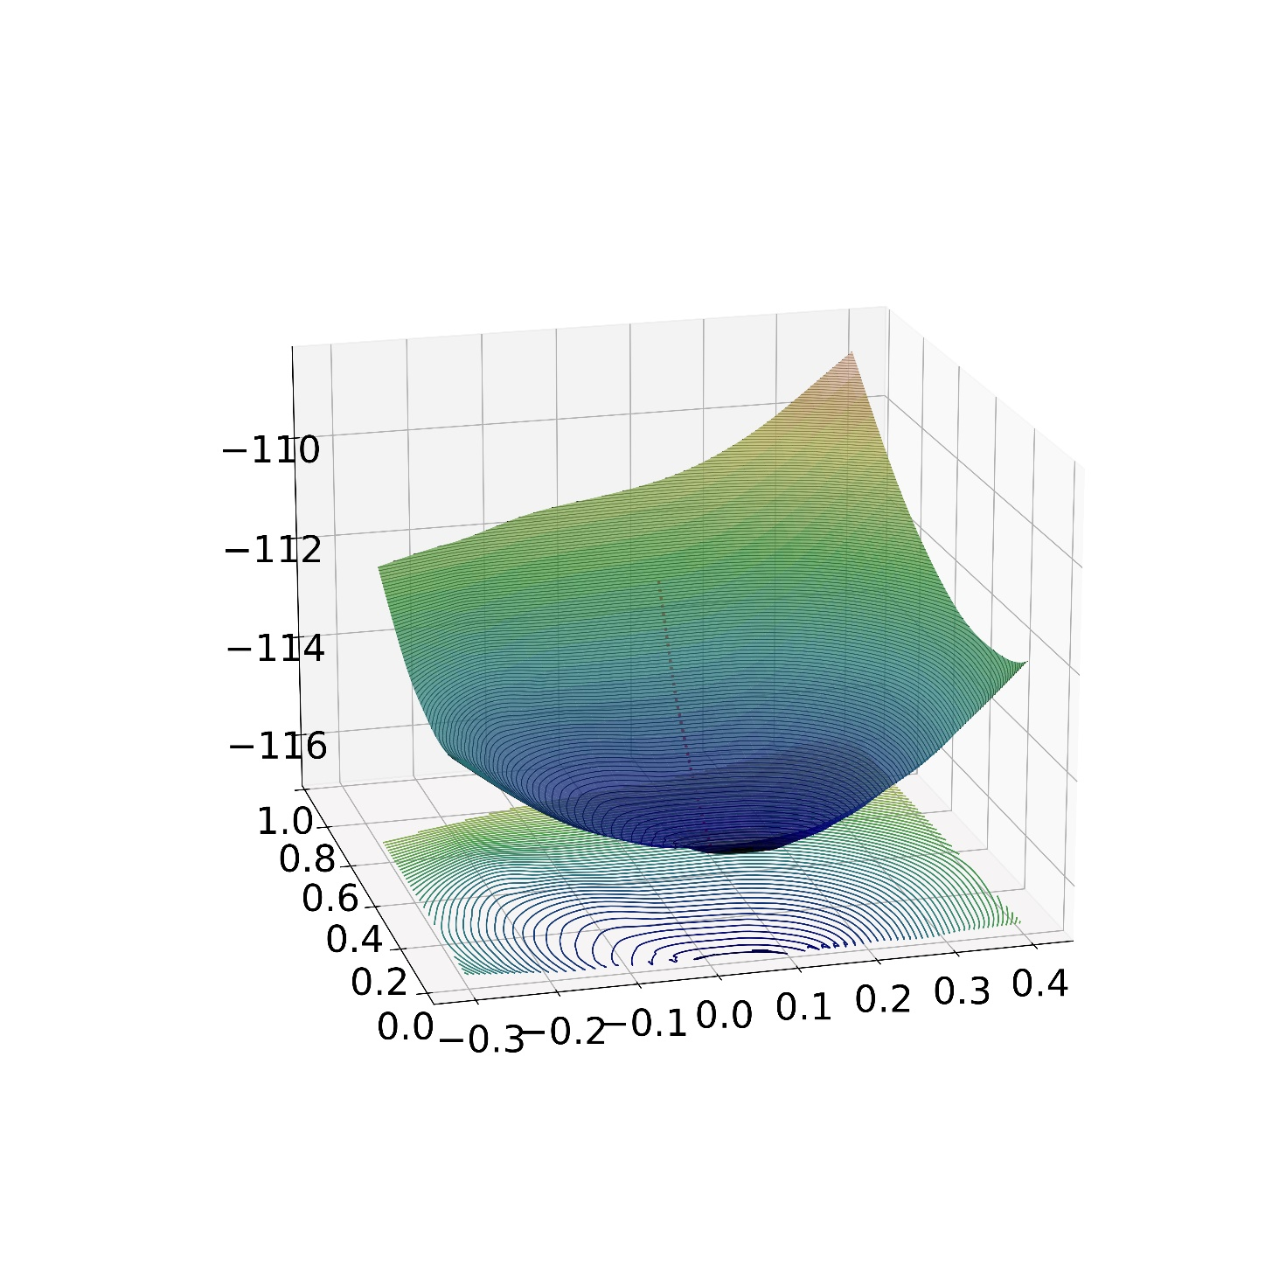
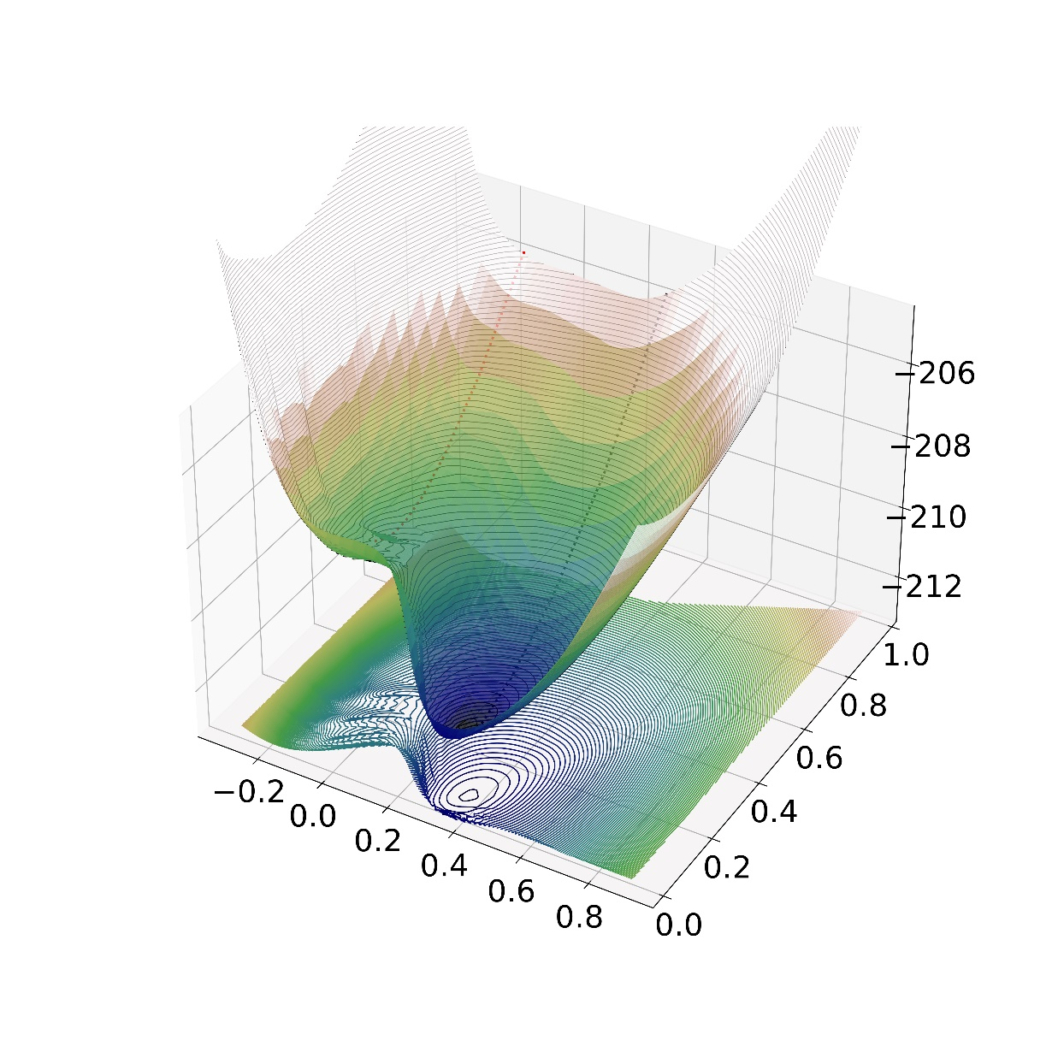
Static correlations and (near) degenerate systems
Order parameter of broken symmetry
II. Towards an optimal combination of SSB and MR
Mean-field energy as a function of broken symmetry(ies)
Use of symmetry-breaking operator Q to constrain symmetry breaking to |q|
Ex: SU(2) (q=ρ₂₀) and U(1) (q=Δ_{pairing})  doubled-constrained UHFB calculations
Vacuum total energy surface (TES)
« Closed-shell » = symmetry-conserving minimum
« Open-shell » = symmetry-breaking minimum
E^{UHFB} (MeV)
²²C
E^{UHFB} (MeV)
³²Ne
[Ebran, Duguet, unpublished]
|Δ_{pairing}|
|Δ_{pairing}|
|ρ₂₀|
|ρ₂₀|
Symmetry conserving = just one particular point when viewed from general perspective of vacuum TES
Vacuum TES contains physics beyond the minimum (symmetry conserving or not)
➲ softness around it indicates further collective/static correlations even for “closed-shell” system

Slide 37
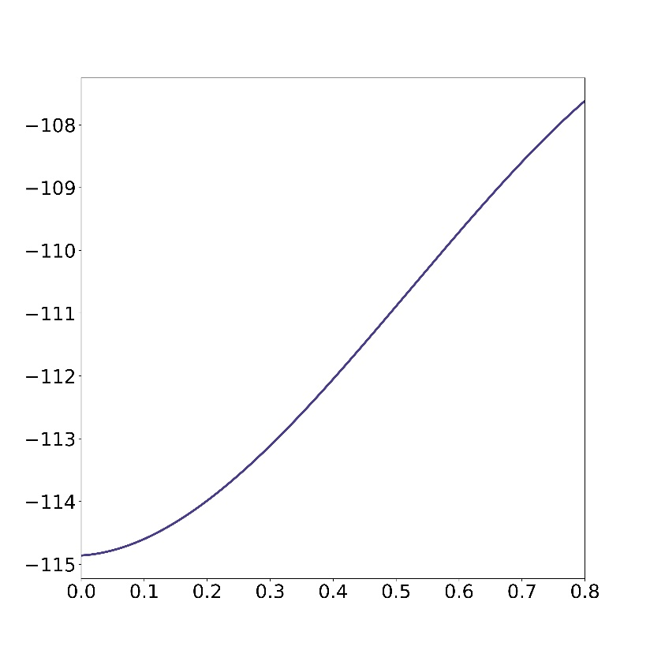
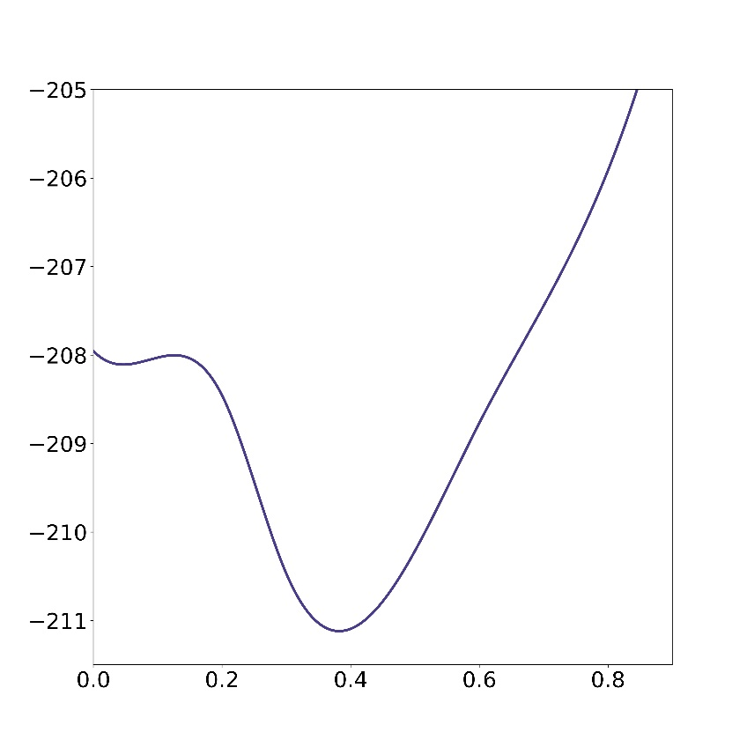
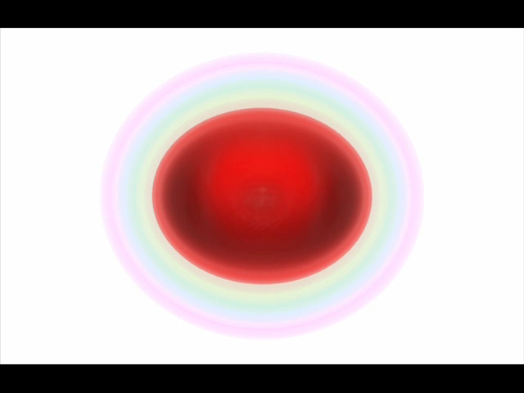
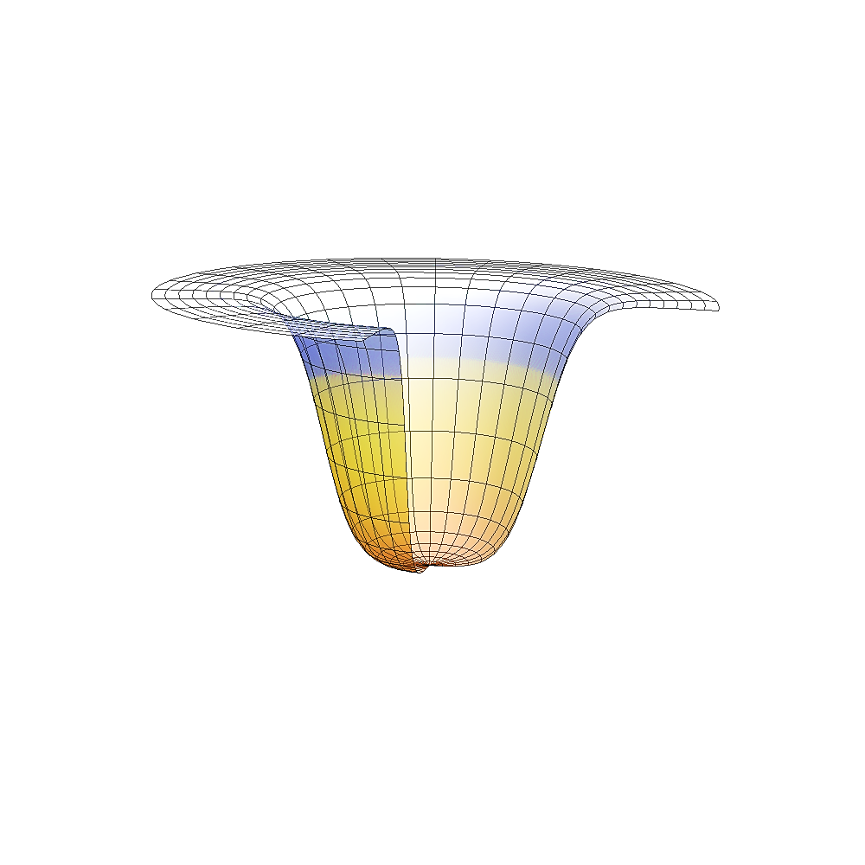
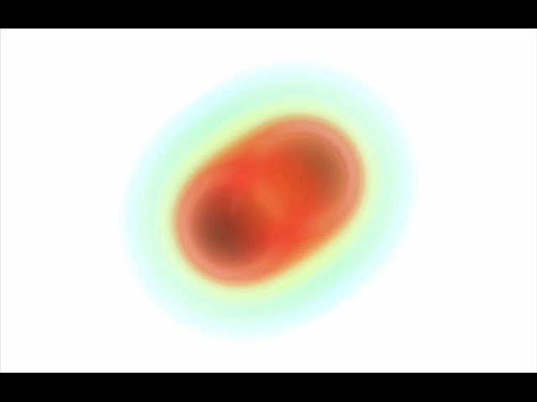
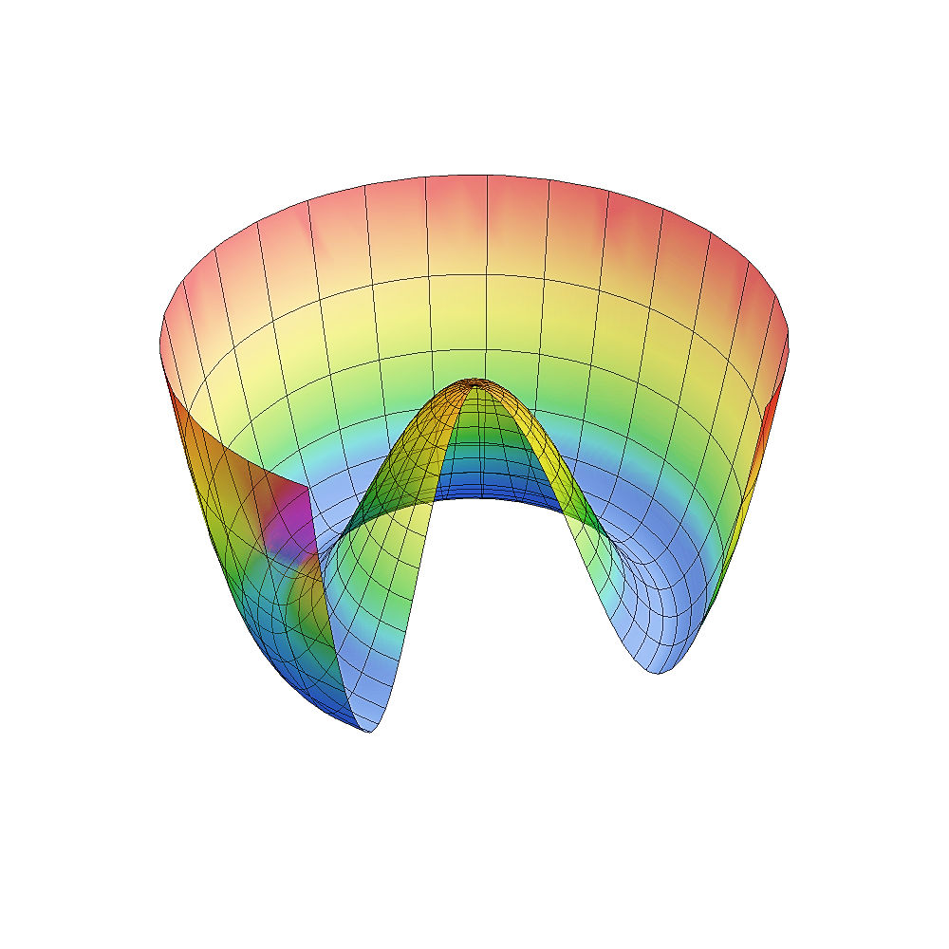
Static correlations and (near) degenerate systems
Order parameter of broken symmetry
II. Towards an optimal combination of SSB and MR
1D projection along ρ₂₀ (≥ 0) at Δ_{pairing} = 0
« Closed-shell » = symmetry-conserving minimum
« Open-shell » = symmetry-breaking minimum
²²C
Vacuum total energy curve (TEC)
³²Ne
Δ_{pairing}=0
Δ_{pairing}=0
E^{UHF}(ρ²⁰) (MeV)
E^{UHF}(ρ²⁰) (MeV)
[Ebran, Duguet, unpublished]
Add Arg(q)
|ρ₂₀|
|ρ₂₀|
E^{UHFB} (q) (MeV)
From (small) diago
[see talk by B. Bally]
E^{UHFB} (q) (MeV)
1) Change of |q| = quadrupole fluctuations
2) Change of Arg(q) = angular rotation
MR state from non-orthogonal vacua (NOV) in IR
Arg(q)
Symmetry-projected state
Capture collective static correlations
1) PGCM in NP
2) NOCI in QC
|q|
|q|
Arg(q)

Slide 38
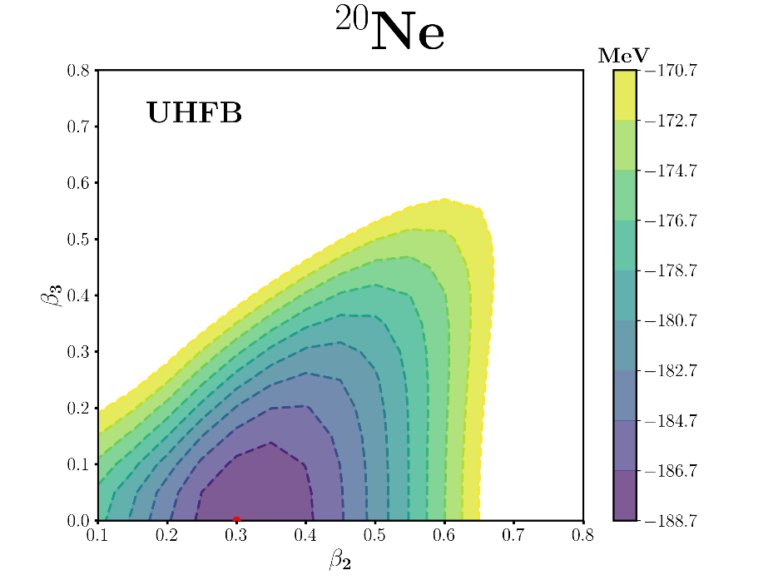
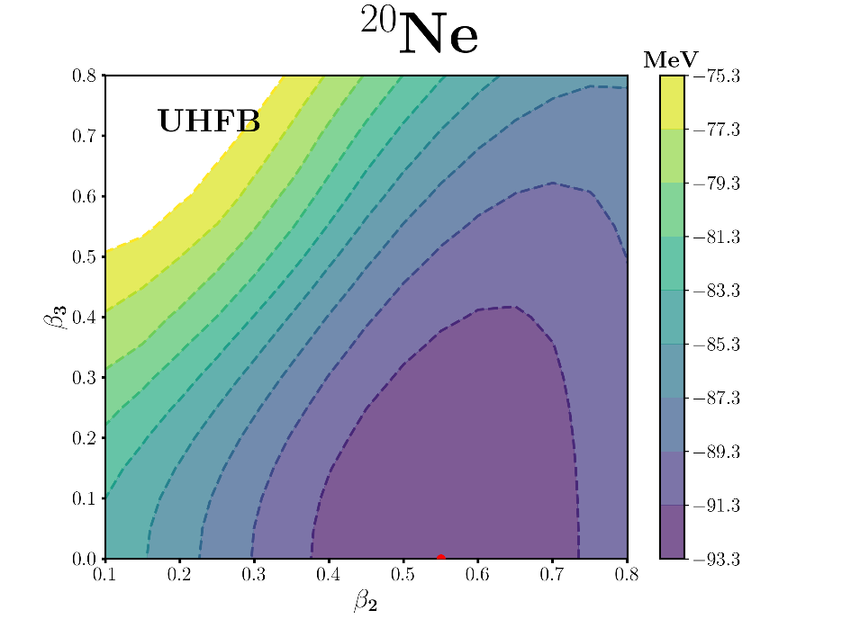
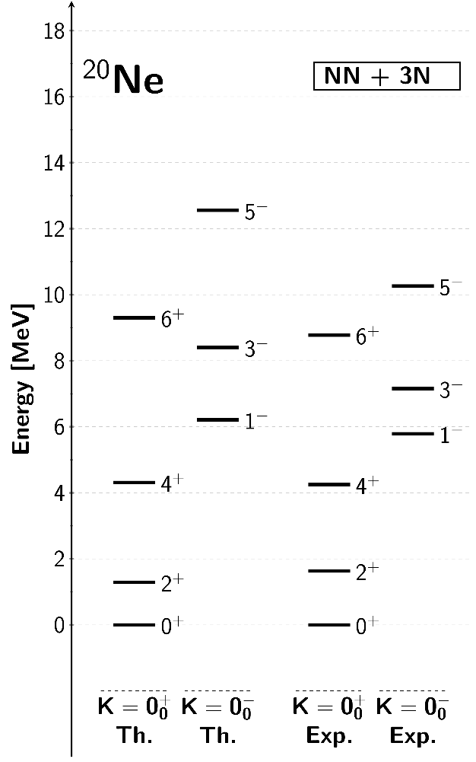

Ex. 2D-PGCM (i.e. NOCI) of ²⁰Ne
2D TES: SU(2) breaking constrained along both q = ρ₂₀ and ρ₃₀ (free U(1) breaking)
 doubled-constrained UHFB calculations
Breaks parity
2N only
2N+3N
⦿ Significative impact of 3N force
|ρ₃₀|
Minima pushed towards larger |ρ₂₀|-|ρ₃₀|
Softer PES
[Frosini et al. unpublished (2021)]
|ρ₂₀|
|ρ₂₀|
: PGCM mix along a) |q| with q = ρ₂₀ and ρ₃₀
b) Arg(q) = projections on J, π, N and Z
⦿ Good reproduction of collective spectroscopy
Static collective correlations captured
RHFB
Correlations
Static
Dynamical
54%
46%
⦿ Significant impact of 3N force
23%
77%
Improved moment of inertia of rotational bands
Very improved 1⁻ band-head position
1) RHFB -82 MeV
2) UHFB -93 MeV
3a) PGCM -100 MeV
3b) UBMBPT(3) -153 MeV
4) Exp -160 MeV
11MeV
⦿ Dynamical correlations missing
7MeV
Absolute binding energy entirely missed
Elementary excitations not accessed
60MeV

Slide 39
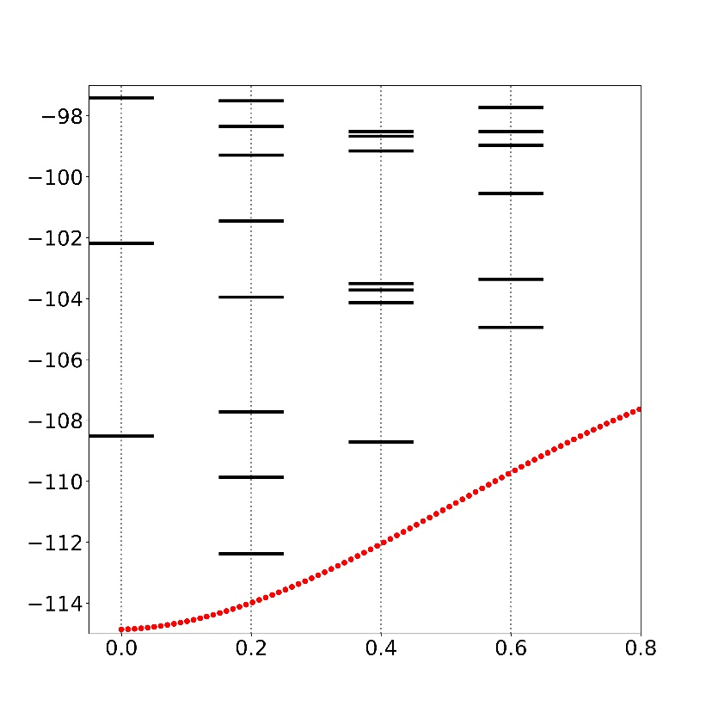
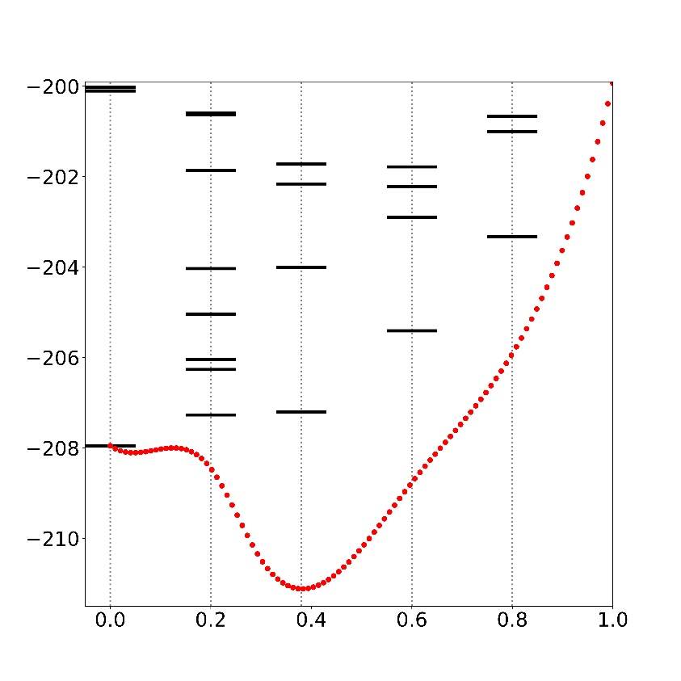
Static correlations and (near) degenerate systems
II. Towards an optimal combination of SSB and MR
Elementary excitations on top of NOV:
« Closed-shell » = symmetry-conserving minimum
« Open-shell » = symmetry-breaking minimum
♦Dynamical correlations minimized via SSB
³²Ne
♦NOV mixing pertinent even in closed-shell
E^{UHF}(ρ²⁰) (MeV)
²²C
E^{UHF}(ρ²⁰) (MeV)
[Ebran, Duguet, unpublished]
♦Dynamical correlations through EE_{q}
Δ_{pairing}=0
Δ_{pairing}=0
Expansions on top of MR-NOV state
ρ₂₀
This idea to consistently capture static and dynamical correlations should be pushed in the future
Two recent examples/proposals
♦MR-IMSRG in NP [Hergert et al. (2013); Yao et al. (2020)]
♦NOCI-PT in QC [Burton, Thom (2020)]

Slide 40
Contents
⦿ Introduction to low-energy nuclear physics
○ Phenomenology
○ Rationale from the theoretical viewpoint
⦿ Strong inter-nucleon forces
○ Basic phenomenology and modelling
⦿ The ab initio nuclear many-body problem
○ Characteristics of the mean-field
○ Pre-processing short-range correlations
○ Expansion methods
○ Dealing with static and dynamical correlations
○ Reducing the numerical scaling
⦿ Conclusions

Slide 41
Many-body tensor networks and basis representation
⦿ Many-body calculations employ mode-n tensors and compute tensor networks
1) Input
2) Output
k-body force
↕
Mode-2k tensor
↕
Basis representation dim N
↕
Storage cost N^{2k}
Evaluated quantities (here energy)
↕
Tensor network of N^{p} cost (here p=4)
↕
Unknown tensors evaluation N^{q} cost (e.g. q=6)
Oscillator frequency
⦿ Basis to represent operators/associated tensors
○ Spherical harmonic oscillator (sHO) basis of H₁
Finite basis set by maximum excitation
○ Tensor-product basis of H_{n} used to represent
Maximum excitation of the n-body basis state set by
Generalized Laguerre polynomials

Slide 42
Many-body tensor networks and basis representation
⦿ Many-body calculations employ mode-n tensors and compute tensor networks
1) Input
2) Output
k-body force
↕
Mode-2k tensor
↕
Basis representation dim N
↕
Storage cost N^{2k}
Evaluated quantities (here energy)
↕
Tensor network of N^{p} cost (here p=4)
↕
Unknown tensors evaluation N^{q} cost (e.g. q=6)
M-scheme
⦿ Challenge to store mode-6 tensors, e.g. 3N force, in large enough basis
J-scheme
JT-scheme
○ Storage/handling of full tensor impossible in Hilbert space initially considered
Jacobi basis
Need e_{1max} ~ 13 (N~2000)/ e_{3max} = 3*E_{1max} ~ 40 in mid-mass systems
[Roth et al. 2014]
Impossible! → Further truncation on e_{3max} mandatory
○ 3N matrix elements files can easily be 100Gb in size
○ CI benchmarks : 4N force quite small (~100keV in ⁴He)
Size of 4N forces in medium-mass systems unknown!

Slide 43
Ex. Pre-processing tools: TF and IT
⦿ Many-body calculations employ mode-n tensors and compute tensor networks
1) Input
2) Output
k-body force
↕
Mode-2k tensor
↕
Basis representation dim N
↕
Storage cost N^{2k}
Evaluated quantities (here energy)
↕
Tensor network of N^{p} cost (here p=4)
↕
Unknown tensors evaluation N^{q} cost (e.g. q=6)
⦿ Push ab initio calculations to (i) doubly open-shell (ii) heavier (A>130) (iii) better accuracy (<1%)
→ Storage/CPU of ab initio calculations scale as N^{n}
Realistic basis dimension
N = 1-body basis dimension
n = characteristic of accuracy/AN force
10⁵ compression
1% error on ΔE⁽⁴⁾
→ Systematic data compression techniques
Tensor Factorization (TF) = acts on n
[Tichai et al. 2018] [see Talk by A. Tichai]
Importance Truncation (IT) = acts on N
IT on ΔE⁽⁴⁾ in ¹⁸O
[Tichai, Ripoche, Duguet 2019]
[Porro et al. unpublished 2021]

Slide 44
Contents
⦿ Introduction to low-energy nuclear physics
○ Phenomenology
○ Rationale from the theoretical viewpoint
⦿ Strong inter-nucleon forces
○ Basic phenomenology and modelling
⦿ The ab initio nuclear many-body problem
○ Characteristics of the mean-field
○ Pre-processing short-range correlations via similarity renormalization group transformations
○ Expansion methods
○ Dealing with static and dynamical correlations
○ Reducing the numerical scaling
⦿ Conclusions

Slide 45
Conclusions

